Slide 1



PUBLIPRENEUR BASED
LANGUAGE LEARNING (PBLL)
As an Approach
Dari Desertasi Berjudul
BAHAN AJAR BAHASA INGGRIS
UNTUK TUJUAN KHUSUS PENDIDKAN WIRAUSAHA PENERBITAN
(Penelitian Pengembangan di Politeknik Negeri Media Kreatif)
Pascasarjana Program Studi Ilmu Pendidikan Bahasa
Universitas Negeri Jakarta, 2014
by Zalzulifa
Notes:
1

Slide 2





CONTENTS
1. INTRODUCTION
4. RESEARCH FINDINGS
Background
PBLL Within Language Teaching Approach
Research Focus
PBLL Within Indonesia Qualification Framework
Research Problems
PBLL Within Industrial Need Construction
Research Impact
PBLL Within Publishing and Creative Industries
2. LITERATURE REVIEW
PBLL Within Asean Economic Community
Model Review
5. CLOSING
Model Choises
Conclusion
Model Design
Implication
3. RESEARCH STEPS
Recommendations
Model Review
Model Review

Slide 3


Bab 1: BACKGROUND
INTERNAL POLICY
Production and Enterprenuership
Competency Based.
Higher Education Constitution (UUPT) No.
12/2013 About IQF (KKNI)
EXTERNAL POLICY
Ministerial Decree No. 60/2008, Polimedia
Focus on Providing quality Human Resources for National Creative Industries.
Publishing as Language Based Competencies as one of Fifteen Creative Sectors
(Trade Ministry, 2007)
The Changing of World basis Economic
Factor from (Agriculture-Industry-Information-
Knowledge).
English as Worldwide Accepted Academic and Business Communication Tool Used in the Era of AEC (MEA) and AFTA
National Economic Development Policy Based of
Creative Economy of Local Content and Cultural
Wealthy.
Notes:
3

Slide 4


Focus and Sub Focus
SUB FOCUS
The Existing Condition of Teaching Learning Process at the Publishing Study Program
FOCUS
Material Development of Vocational English for Publishing Business Purposes
The Formation of English Material for Publishing Business Purposes.
The Effectiveness of Materials for Publishing Business Purposes
Notes:
4

Slide 5


Problem Identifications
List of Problems
The quality input of accepted students
Limited time allocated for teaching English
Students do not have enough time to actually learn to speak English in class because the lecturer is more concerned to teach grammar and syntax
Learning Targets
Skillful in editing and writing manuscripts
The absence of good and authentic learning materials
Skillful in planning and managing their publishing business
The absence of the social uses of English outside the classroom
The absence of national occupational competence in Indonesia Publishing Industry
No students and industrial need assessment
Notes:
5

Slide 6

MODEL CHOICES
Self-Publishers
Behavioral Approaches
Communicative Approaches
Writing
Pavlov (1849-1936)
Watson (1878-1958)
Skinner (1904-1990)
7. Delivering
Reading
6. Marketing
5. Publishing
Speaking
4.
Editing
Listening
3.
Revising
Speaking
2.
Drafting
Listening
1. Prewriting
Writing
Task-based Approaches
Competency Based Approaches
PBLL
Reading
Dave and Jane Willis (2007)
Bruton A (2005)
Nunan, D (2004)

Slide 7
FIELD OF LANGUAGE STUDY
A. LINGUISTIC
PURE |  | INTERDICIPLINER/ MACROLINGUISTIC |  | APPLIED
01.Bunyi (Phonology) 02.Morphem (Morphology) 03.Words (Leksikology) 04.Kata sbg Tanda (Semiotic 05.Frasa & Kalimat (Syntax) 06.Makna (Semantic) |  | 01.Sosiolinguistic 02.Psikolingustic 03.Antropolinguistic 04.Politilinguistic 05.Sosiopolitinguistic 06.Etnolingustic 07.Neurolinguistic 08.Geolinguistic 09.Historilinguistic 10.Komputasilinguistic 11.Teori Komunikasi |  | 01.Evaluasi Bahasa 02.Bahasa dalam Pendidikan 03.Pemerolehan Bahasa Model Bahan Ajar Bahasa Inggris untuk Tujuan Khusus Pendidkan Wirausaha Penerbitan (R&D di Polimedia Pembelajaran Bahasa Pendekatan Wirausaha Penerbitan / Publipreneur Based Language Learnng (PBLL) Prewriting-Drafting-Revising-Ediiting-Publishing- Marketing-Delivering)
B. LITERATURE
FORM |  |  |  |  | TIME
Prosa | Puisi |  | Drama | Klasik | Peralihan | Modern
Kuno 1.Dongeng 2.Legenda 3.Mitos 4.Hikayat 5.Fabel Peralihan 1.Biografi 2.Riwayat 3.Otobiografi Baru 1.Roman 2.Novel 3.Lirik | Kuno 1.Pantun 2.Gurindam 3.Mantra 4.Syair Baru 1.Soneta 2.Puisi Bebas 3.Kontemporee |  | Kuno 1.Opera 2.Wayang 3.Ludruk 4.Ketoprak 5.Reog Baru 1.Sandiwara 2.Komedi 3.Tragedi 4.Pantomim | 1.Purba 2.Hindu 3.Islam | Zaman Abdulah Bin Abd Kadir Munsyil | 1.Balai Pustaka 2.Pujangga Baru 3.Angk 45 4.Angk 66 5.Kontemporer

Slide 8
Language Teaching Trends
Factors in Language Teaching Trend from Publisher side:
  Authors’ Influence
  Editors’ influence
  Reader’s influence
  Book reviewers’ influence
  Rasearch influence
  Government policy directive
  Educator-led innovation
  Response to technology
  Learners’ based creation
  Crossover educational trends.
  Crossover from other desciplines
OUT
PUT
Learners
Interlanguages
OUT
COME
INPUT

Slide 9
PUBLISHING COMPETENCE
No. Unit | American Book Publishers
1 | Define the Vision and Business Strategy
2 | Develop Books and Publishing Packages
3 | Edit Books
4 | Promote Books
5 | Distribute Books
6 | Manage Information
7 | Manage Rights and Contracts
8 | Manage Human Resources
9 | Manage Financial Resources
10 | Manage Physical Resources
11 | Demonstrate Communication and Interpersonal Skills
12 | Demonstrate Personal Skills
No. Unit | American Magazine Publishers
1 | Provide Content and Design for Print and Digital
2 | Produce Magazine Issues and Digital Content
3 | Manage Distribution
4 | Sell Services to Advertisers
5 | Manage Business Development
6 | Generate Alternative Revenues
7 | Promote the Brand
8 | Manage Human Resource Function
9 | Manage Finance
10 | Manage Business Operation
11 | Comply with Laws and Regulations
12 | Demonstrate Personal Skills
13 | Demonstrate Interpersonal and Communication Skills
No. Unit | UK Book Publishers
1 | Commissioning and Acquisition
2 | Right
3 | Contracts
4 | Design (Visual)
5 | Editorial Management
6 | Design (Structural)
7 | Editing
8 | Production
9 | Marketing and Direct Sales
Sumber:
1. Pubishing Training Centre, 2010
2. Canada Human Resource Training Gap Analysis in Publishing Industry, 2010

Slide 10



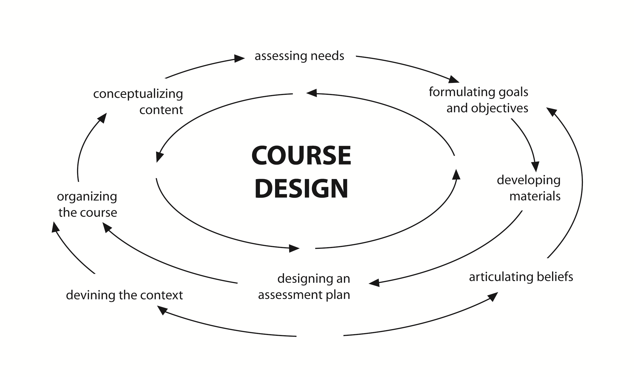












Models Tobe Developed
ACTUALIZING CONCEPT
Assessing Needs
Conceptualizing Contents
Formulating Goals and Objectives
COURSE DESIGN
Organizing Course
Developing Materials
Designing an Assessment Plan
Defining the Content
Articulating Beliefs
Kathleen Graves, Designing Language Course. Pp3/2000

Slide 11
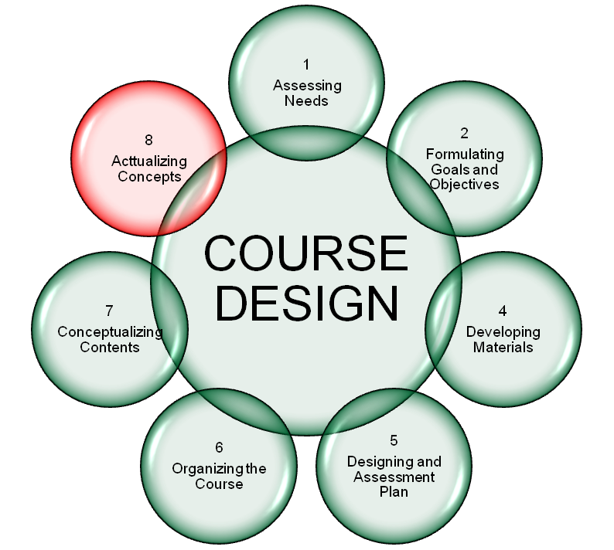
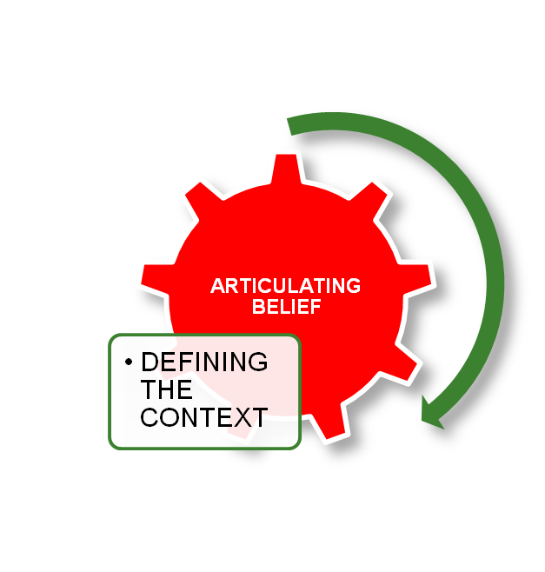

2. ADAPTED FRAMEWORK
********* EDUCATIONAL WORLD *********
Adapted from Kathleen Graves, Designing Language Course. Pp3/2000

Slide 12

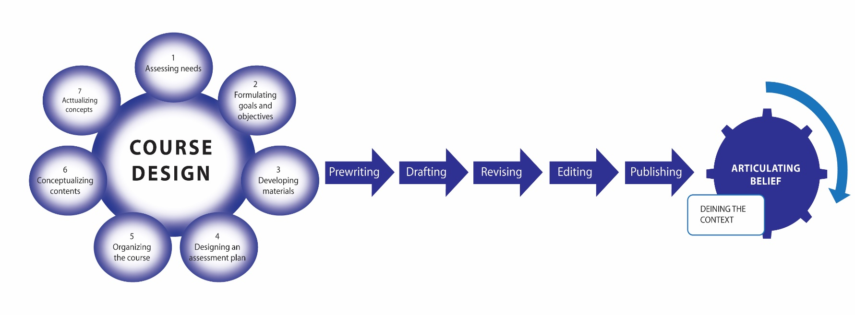
Visual Language
Verbal Language
How to Think, How to Create,
How to Apply, How to Develop
Reading, Writing, Speaking, Listening
Prewriting-Drafting-Revising-Editing-Publishing-Marketing-Delivering
PBLL
NASKAH
(Names, Accessories, Sources, Kinds/Qualifications, Anatomy, How)
Teamworking skills, oral communication skills, problem solving skills, customer handling skills, negotiating skills, management skills, general IT user skills, technical and practical skills, office administration skills, written communication skills, literacy skills, numeracy skills, IT professional skills, foreign language skills, grappling with grammar skills, speed reading skills, note-taking skills.

Slide 14

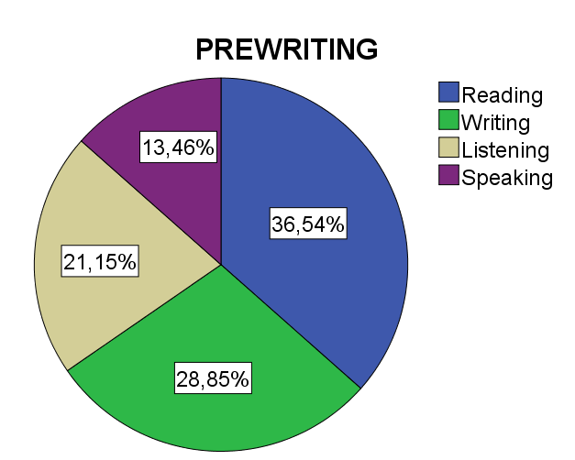
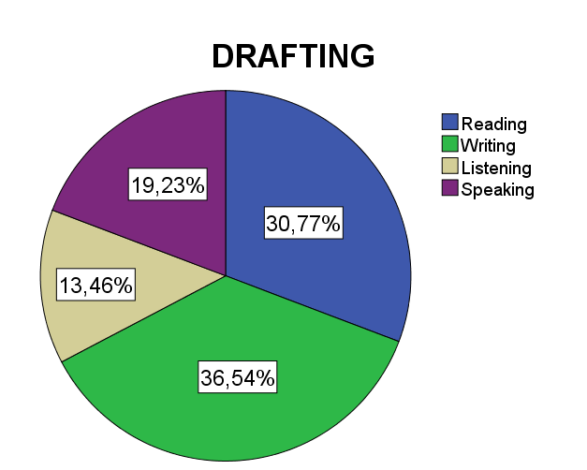
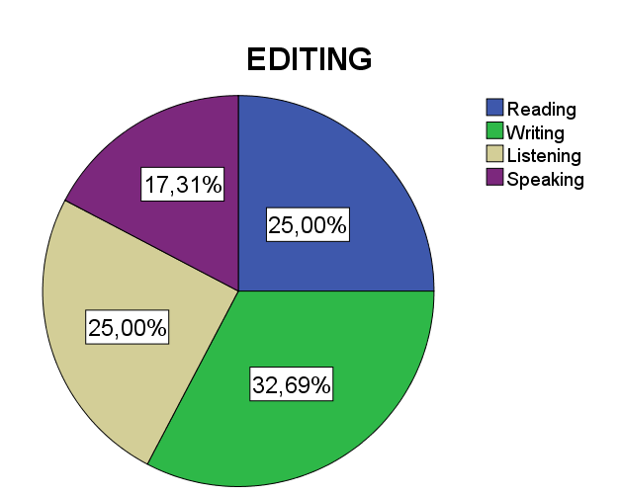
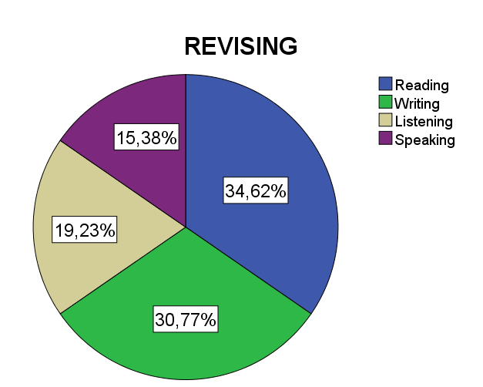
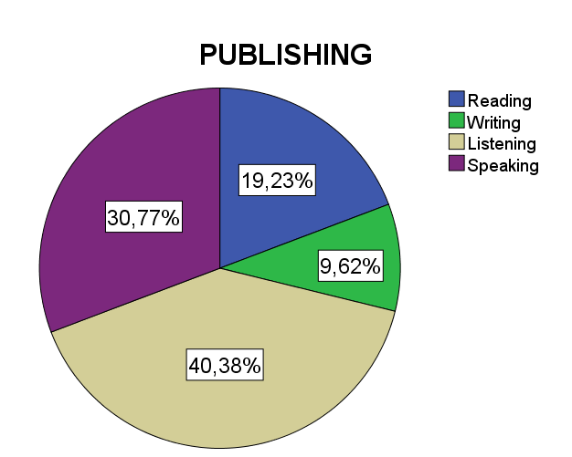
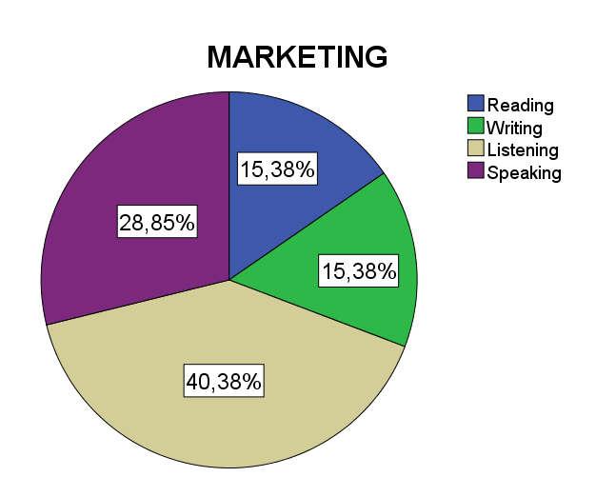
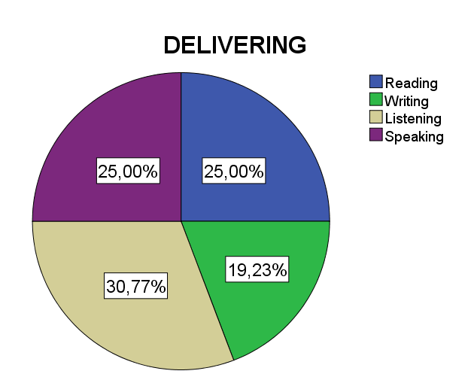


Slide 15


INPUT:
Reading, Writing, Listening, Speaking In Publishing Business Competencies (Commissioning and Aquisition; Right; Contract; Design Visual; Editorial; Management; Design Structural; Editing; Production) implemented through prewriting, drafting, revising, editing, publishing, marketing, delivering.
LEARNING MAPS OF THE PUBLIPRENEUR BASED LANGUAGE LEARNING (PBLL)
Learning Process | Skill Competencies | Learning Output | Learning Outcome | Employability Skill
Students’ Assignment | Prewriting, | Raw Materials | Task Skills | Technical Skill (Psychomotoric)
 | Dafting, | Dirty Copy | Task Skills
 | Revising, | Revised Copy | Task Skills
 | Editing, | Clean Copy | Task Skills
 | Publishing, | Dummy | Task Skills
 | Marketing | Finished Products | Task Skills
 | Delivering | Online & Offline | Task Skills
Class Participation (Speech, Discussion, Case Study, ect) | Writer | Writing Proposal & Business letter | Management Skills | Sosial and Emotional Skill (Affective)
 | Presenter | Speaking based on presentation slide | Contngency Skills
 | Moderator | Time Management | Management Skills
 | Adjudicator | Observing Resources | Management Skills
 | Team Worker | Editorial Team Role Play | Environmetal Skills
Mid-Terms Test | Editor | Personal Editing skills (mechanical) | Task Skills Contigency Skills | Knowledge (Cognitve)
Final Test | Editor | Personal Editing skills (substantive and pictorial) | Task Skills Contingency Skills | Knowledge (Cognitve)
Assessment Test | Publisher | Employability Skill (Editorial, Production, Marketing) | Skills of Task, Management, Contingency, Environmental | Quality Assurance (Job Related)

Slide 17

2008
PBLL
2014
MODEL REVIEW
GRADUATE: competence, profile, career prospects, job vacancy, learning process, learning facilities
STUDY PROGRAMS:
TOURISM
Hotel
Travel Agency
AVIATION
Ground Handling
Ground Support Equipment
Aircraft Structure
Cabin Technician
CREATIVE INDUSTRY
01.PUBLISHING
02.DESIGN
03.PRINTING
04.PCKAGING
05.MULTIMEDIA
06.ANIMATION
07.BROADCASTING
08.MODE
09.PHOTOGRAPHY
10.ADVERTISING
11.RADIO
12.TELEVISION
13.FILM
14.MUSIC
15.CRAFT
16.CULINARY
SUPPORT SYSTEM:
Students, Lecturers, facilities, Methods
LEARNING STRATEGY:
Production and Entrepreneurship Based
Outcome:
Academic
Students’ outlook
Graduate employability
SKILL NEEDS OF ENGLISH:
Reading
Writing
Listening
Speaking
VISION: VISION: Scouting learner to be self-publishers
6. Marketing
(Provide the products to marketing targets
5. Publishing
(Share your idea in written form)
7. Delivering
(Deliver the products to clients
4.
Editing
(Find and correct any mistakes have made)
3.
Revising
(Share and reflect on your first draft)
2.
Drafting
(Get your idea down on paper)
1. Prewriting
(Think and Plan)

Slide 18
LEARNING TREATMENT OF PUBLIPRENEUR BASED LANGUAGE LEARNNG (PBLL)
No | Learning Activities | Weekly Time Schedule From 1 to 16 |  |  |  |  | LSP
 |  | I | II-VII | VIII | IX-XV | XVI | -
A | PREWRITING
1 | Writing talent scouting
2 | Data collecting (Blog Building)
3 | Reading for writing
B | DRAFTING
1 | Slide Drafting
2 | Proposal Drafting
3 | Business letter drafting
C | REVISING |  |  |  |  |  | A
1 | Composition Focus |  |  |  |  |  | S
2 | Language Focus |  |  |  |  | F | S
3 | Peer Review & Final Draft |  |  |  |  | I | E
D | EDITING | P |  | M |  | N | S
1 | Mechanical editing | R |  | I |  | A | S
2 | Substantive editing | E |  | D |  | L | M
3 | Pictorial Editing |  |  |  |  |  | E
E | PUBLISHING | T |  | T |  |  | N
1 | Layouting | E |  | E |  | T | T
2 | Designing | S |  | S |  | E
3 | Illustrating | T |  | T |  | S | T
F | MARKETING |  |  |  |  | T | E
1. | Personal marketing |  |  |  |  |  | S
2. | Group marketing |  |  |  |  |  | T
3 | Offering project to clients
G | DELIVERING
1 | Online-Delivering (BLOG)
2 | Offline-Delivering (VIDEO)
3 | Print-Delivering (?)

Slide 19
LANGUAGE
SKILLS
Reading
Writing
Listening
Speaking
Team-working
Oral Communication
Problem Solving
Customer Handling
Management
IT User
Technical and Practical
Office Administration
Written Communication
Literacy
Numeracy
Foreign Language
Grammatical
Note-taking
Negotiation
Speed Reading
NASKAH
-Names
-Accessories
-Sources
-Kinds/Qualifications
-Anatomy
-How
P
B
A
T
5W1H
TECHNICAL
SKILLS
SELF-PUBLISHER
RALLCP
-Readability
-Accuracy
-Legibility
-Legality
-Consistency
-Production details
Prewriting
Drafting
Revising
Editing
Publishing
Marketing
Delivering
PUBLISHING COMPETENCIES
Gambar 1:
Draft Awal Struktur Fisik Bahan Ajar Bahasa Inggris untuk Tujuan Khusus Pendidikan Wirausaha Penerbitan
(Publipreneur Based Language Learning-PBLL)

Slide 20
LANGUAGE
SKILLS
Reading
Writing
Listening
Speaking
Team-working
Oral Communication
Problem Solving
Customer Handling
Management
IT User
Technical and Practical
Office Administration
Written Communication
Literacy
Numeracy
Foreign Language
Grammatical
Note-taking
Negotiation
Speed Reading
NASKAH
-Names
-Accessories
-Sources
-Kinds/Qualifications
-Anatomy
-How
P
B
L
L
Role Play
Task Based
5W1H
Prewriting
Drafting
Revising
Editing
Publishing
Marketing
Delivering
TECHNICAL
SKILLS
Self-Publisher
RALLCP
-Readability
-Accuracy
-Legibility
-Legality
-Consistency
-Production details
Commisioning and Aquisition
Right
Contract
Design (Visual)
Editorial Management
Design (Structural)
Editing
Production
Marketing and Direct Sales
Gambar 2:
Draft Rekomendasi Struktur Fisik Bahan Ajar Bahasa Inggris untuk Tujuan Khusus Pendidikan Wirausaha Penerbitan
(Publipreneur Based Language Learning-PBLL)
PUBLISHING COMPETENCIES

Slide 21
LANGUAGE
SKILLS
Reading
Writing
Listening
Speaking
NASKAH
-Names
-Accessories
-Sources
-Kinds/Qualifications
-Anatomy
-How
SELF-P
U
B
L
I
S
H
E
R
S
Team-working
Oral Communication
Problem Solving
Customer Handling
Management
IT User
Technical and Practical
Office Administration
Written Communication
Literacy
Numeracy
Foreign Language
Grammatical
Note-taking
Negotiation
Speed Reading
P
B
L
L
Role Play
Task Based
Prewriting
Drafting
Revising
Editing
Publishing
Marketing
Delivering
TECHNICAL
SKILLS
5W1H
RALLCP
-Readability
-Accuracy
-Legibility
-Legality
-Consistency
-Production details
Commisioning and Aquisition
Right
Contract
Design (Visual)
Editorial Management
Design (Structural)
Editing
Production
Marketing and Direct Sales
Gambar 3
Struktur Final Fisik Bahan Ajar Bahasa Inggris untuk Tujuan Khusus Pendidikan Wirausaha Penerbitan
(Publipreneur Based Language Learning-PBLL)
PUBLISHING COMPETENCE

Slide 22
MODEL’S BENEFITS
THEORETICAL BENEFITS
Strengtening the exising theory
Knowledge Enhancement
Educational Concept Contribution
PRACTICAL BENEFITS
Educators (Lecturer, Teacher, Trainer)
Students
Institutions
Publishing and Other Creative Industry
Societies
Researchers
Notes:
22

Slide 23
PBLL WITHIN LANGUAGE TEACHING APPROACH
Production Based (Prewriting, Drafting, Revising, Editing, Publishing) |  |  |  | Entrepreneurship Based (Marketing and Delivering) |  |  | Learner Base
Basic Skills | Compe-tencies | Product Types | Technical Skills | NASKAH (Code of Conduct) | Value | Users | Approaches | Method
R= Reading | PRE= Prewriting | Descriptive |  | Names Accessories Sources Kinds/ Qualifications Anatomy How --------------- Readibility Legibility Accuracy Consistency Legality Production details | To Educate To Inform To Entertain | 01.PUBLISHING 02.Broadcasting 03.Graphic Design 04.Multimedia 05.Animation 06.Printing 07.Advertising 08.Packaging 09.Crafting 10.Music 11.Radio,TV&Film, 12.Architectures 13.Software 14.Research 15.Culliner | 01. Communicative 02.Competency-Based 03.Content-Based Instruction 04.Cooperative Learning 05.Lexical Approaches 06.Multiple Intelligent 07.The Natural Approach 08.Neurolinguistic Programming 09.Task-Based Approaches 10.Whole Language. 11.Audiolingualisn 12.Counselling-Learning 13.Situational 14.The Silent Way 15.Suggestpedia 16.Total Physical Response. 17.Publipreneur Based Language Learning (PBLL) | 5W1H
 |  | Comparative | 01.Teamworking Skill
 |  | Critical | 02.Oral Communication Skill
 |  | Synthesis | 03.Problem solving Skill
Total |  |  | 04.CUstomer handling Skill
W= Writing | D= Drafting | Documentation | 05.Negotiation Skill
 |  | Reportorial | 06.Management Skill
 |  | Exploratory | 07.General IT user Skill
Total |  |  | 08.Technical Skill
L= Listening | RE= Revising & Editing | Intensive | 09.Office administration skill
 |  | Responsive | 10.Letter writing skill
 |  | Selective | 11.Literacy skill
 |  | Extensive | 12.Numeracy skill
Total |  |  | 13.IT professional skill
S= Speaking | P= Publishing | Productivity | 14.Foreign language skill
 |  | Interactivity | 15.Grammar skill
 |  | Safety | 16.Speed reading skill
 |  | Authenticity | 17.Note-taking skill
Total |  |  | 18.Skimming skill
M= Marketing |  | Speaking | 19.Skipping skill
D= Delivering |  | Delivering | 20.Scanning skill
Code: R+W+L+S+PREDREP+MD
Learning Portfolios
Understanding Language Usage in publishing various products, such as: Leaflets, Brochures, Banner, Flier, Book, Magazine, Newspaper, Business Letter, Proposal

Slide 24
PBLL WITHIN INDONESIA QUALIFICATION FRAMEWORK
AKADEMIC LEVEL | SKKNI LEVEL | AREA BIDANG / SUB BIDANG PEKERJAAN / JABATAN
 |  | Kualifikasi Berjenjang |  |  |  |  | Kualifikasi Bahasa Inggris
 |  | BAHASA INGGRIS UNTUK PENERBITAN
 |  | EDITOR PROFESSIONALS
 |  | Potensi Adaptasi | United Kingdom |  | UKBI
S3 (Doktor Teraoan) (Doktor) | Sert IX | Editor Utama (Publisher) | Editor Director |  | Istimewa (860-900) |  | -/ 590-677
Sp1/S2 (Magister Terapan) (Magister) | Sert VIII | Editor Madya (Editor Director) | Senior Editor |  | Sangat Unggul (717-816) |  | -/ 550-587
 | Sert VII | Editor Muda (Senior Editor) | Managing Editor |  | Unggul (593-716) |  | Proficiency/ Advance (525-677)/ 513-547
D4/S1 (Sarjana Teraoan) (Sarjana) | Sert VI | Kopi Editor Utama (Managing Editor) | Assoociate Editor |  | Madya (466-592) |  | Upper/ High Intermediate (480-520)/ 477-510
 | Sert.V | Kopi Editor Madya (Associate Editor) | Copy Editor |  | Semenjana (346-465) |  | Pre/ Low Intermediate (420-480)/ 437-473
D3 (Ahli Madya) | Sert.IV | Kopi Editor Muda (Copy Editor) | Assistant Editor |  | Marginal (247-345) |  | Elementary (310-420)/ 347—433)
 |  | Executive Secretary
D2 (Ahli Muda) | Sert.III | Korektor Utama (Assistant Editor) | Editorial Assistant |  | Terbatas (162-246) |  | Pre-elementary (347-393)
 |  | Secretary | Senior Secretary
D1 (Ahli Pratama) | Sert.II | Korektor Madya (Editorial Assistant) | - |  |  |  | Beginner (310-343)
 |  | Junior Secretary
SMU/SMK | Sert.I | Korektor Muda (Corector) | - |  |  |  | Basics (0-310)
 |  | Receptionist |  | Telephone Operator |  | Typist
Notes:
24

Slide 25

PBLL WITHIN INDUSTRIAL NEEDED SKILL QUALIFICATION
DIRECTOR (CEO)
EDITORIAL
DEPARTEMENT
PRODUCTION
DEPARTEMENT
MARKETING
DEPARTEMENT
TREASURY
DEPARTEMEN
.
HRD
DEPARTEMENT
Editor Utama
(Publisherr)
Rancang Grafis
(Designer)
Promsi
(Promotion)
EDP
Humas
Akuntasi
SDM
Editor Madya
(Editor Director)
Juru Setting
(Setters)
Penjualan
(Salesman)
Bendahara
Teknisi
Anggaran
Keamanan
Editor Muda
(Senior Editor)
Illustrasi
(Illustrators)
Kopi Editor Utama
(Managing Editor)
Kopi Editor Madya
(Associate Editor)
Kopi Editor Muda
(Copy Editor)
Korektor Utama
(Assistant Editor)
Korektor Madya
(Proof Readers)
Korektor Muda
(Corector)
25

Slide 26


PBLL WITHIN PUBLISHING AND OTHER CREATIVE INDUSTRIES
PRODUCTION
BASED
TOURISM
01.Hotel and Hospitality
02.Travel Agency
AIRCRAFT
01.Ground Handling
02.Cabin Maintenance
03.Cabin Structure Technician
04.Cabin Crew
05.Ground Support Equipment
CREATIVE INDUSTRIES:
01.PUBLISHING
02.Design
03.Printing
04.Multimedia
05.Advertising
06.Packaging
07.Broadcating
08.Fashion
09.Film
10.Music
11.Architects
12.Craft
13.Mice
14.Research & Development.
15.Cullinary
CAREER IN PUBLISHING COMPANY:
01.Editor Utama
(Publishers)
02.Editor Madya
(Editor Director)
03.Editor Muda
(Senior Editor)
04.Kopi Editor Utama
(Managing Editor)
05.Kopi Editor Madya
(Associate Editor)
06.Kopi Editor Muda
(Copy Editor)
07.Korektor Utama
(Asisten Editor)
08.Korektor Madya
(Editorial Asistant)
09.Korektor Muda
(Corrector)
PREWRITING
DRAFTING
REVISING
EDITING
PUBLISHING
ENTERPRENEURSHIP
BASED
MARKETING
DELIVERING

Slide 27
PBLL Within Asean Community 2015 and Free Trade Policy
FREE TRADE
5W1H
STATE COMMITMENT
Free Flow of Food
Priority of Integration Sectors
Free Flow of Services
Food, Agriculture and Forestry
Free Flow of Investment
Intelectual Property Rights
Free Flow of Capital
Insfrastructure Development
Free Flow of Skill labor
E-Commerce
PBLL
KNOWLEDGE BASED
Thinking Skills
Leadership Skills
BILLINGUAL PROFICIENCY
Ethic and Spirituality
National Dignity
Notes:
27

Slide 28




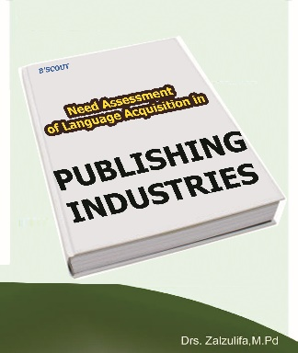













LIST OF MODELS
Notes:
28

Slide 29


4. CLOSING
SIMPULAN
(Conclusion)
PBLL as Learning Approach.
PBLL as Learning System
PBLL as Learning Method.
IMPLIKASI
(Implication)
REKOMENDASI (Recommendation)
Tuntutan standar kompetensi profesi editor dalam industry penerbitan.
Mendorong pembelajaran berbasis kompetensi produksi dan wirausaha.
Menyusun bahan ajar Pembelajaran Bahasa Pendekatan Wirausaha Penerbitan acuan SKKNI Penerbitan.
The Aplication of Reading, Writing, Listening, Speaking within Prewriting, Drafting, Revising, Editing, Pblishing, Marketing, Delivering.
Menjadikan ilmu penerbitan sebagai materi ajar inklusi pada setiap materi ajar pendidikan vokasi.
Mendorong Pembelajaran Tuntas Pendekatan Wirausaha Penerbitan
Notes:
29

Slide 30
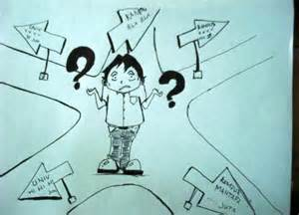
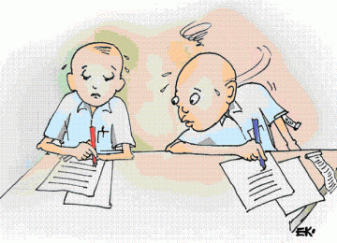
SHIFTING FROM STUDYING TO
THE LEARNING PHILOSOPHY
TEACHERS
STUDENTS
STUDYING
LECTURERS
LECTURING
FACILITATOR
LEARNERS
MOTIVATOR
INOVATOR
LEARNER’S TASKS
1.Create a Personal Blog
2.Have a Plastic Folder
1.Find a Short Article
5.Translate the sentences
2.Build 5W1H Sentences
6.Give reasons why writer uses
the tenses
3.List Verbal and Nominal Sentences
7.Put every single activities into
blog and plastic folder
4.Identify tenses and it’s pattern

Slide 31

THANKS
Ohio Digital Laboratory Who Help This Projects
Boss
Sosepth Butso
Marios Ye
Shirley Wu

